Slide 1
Linear Regression

Slide 2
Typical Data Science Cycle
Data Collection
Business Insights & Understanding
Data Understanding
Model Building & Evaluation
Data Pre-Processing

Slide 3
Machine Learning
Supervised ML
(Target Variables)
Classification
Regression
Linear Regression (Causal) , Time Series
Logistic Regression , Decision Tree

Slide 4

Example
The band makes a loss if less than 3500 people attend.
Based on predicted hours of sunshine, can we predict ticket sales?
Are sunshine and concert attendance correlated?
Sunshine (hours) | 1.9 | 2.5 | 3.2 | 3.8 | 4.7 | 5.5 | 5.9 | 7.2
Concert attendance (100) | 22 | 33 | 30 | 42 | 38 | 49 | 42 | 55
Notes:
Image Source: http://blurtonline.com/wp-content/uploads/2013/06/Shaky-Knees-1514.jpeg;
Last accessed: May 1, 2014

Slide 5
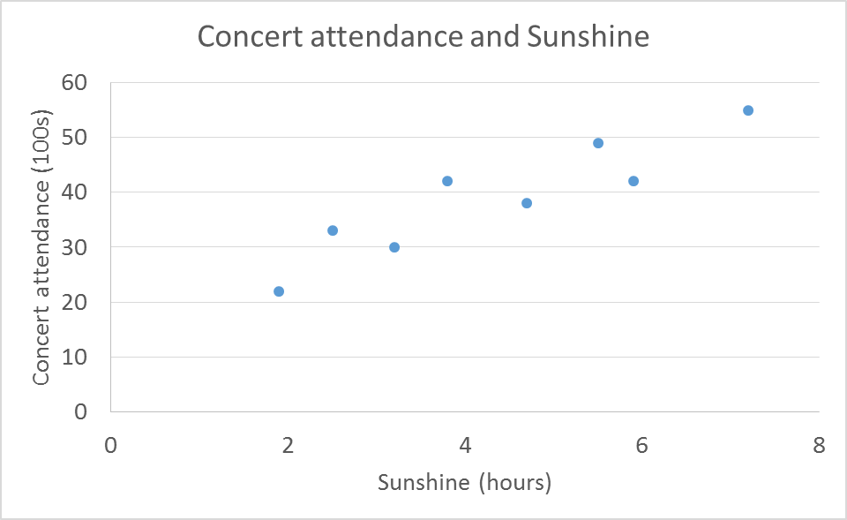
Example
Independent variable (explanatory) – Sunshine – Plotted on X-axis
Dependent variable (response) – Concert attendance – Plotted on Y-axis
Hours of sunshine and concert attendance are correlated, i.e., in general, longer sunshine hours indicate higher attendance.

Slide 6
Example
We need to define this linear relationship by an equation
y = a + bx
b
a

Slide 7
Linear Regression
Linear regression is a linear approach for modeling the relationship between a dependent variable and one or more explanatory variables (or independent variables).
Two Main Objectives
1. Establish if there is a statistically significant relationship between two variables. (Prediction and Prescription)
–E.g. Hours of Sunshine and concert attendance, Income and Spending, Student height and exam scores.
Forecast new observations. (Prediction)
–E.g. How many people will attend concert if I know total sunshine hours.

Slide 8
Linear Regression
y = β0 + β1x + ε
–y is the dependent variable
–x is the independent variable
–Β0 is the constant or intercept
–Β1 is x’s slope or coefficient
–ε is the error term

Slide 9
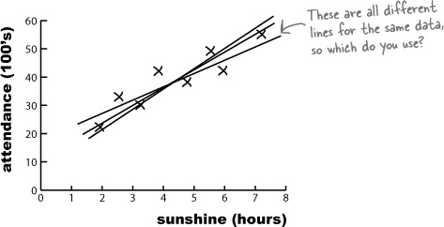
Linear Regression : Process
Line of best fit : Line of best fit refers to a line through data points that best expresses the relationship between those points
a1 + b1*x
a2 + b2*x

Slide 10
Linear Regression : Process
Line of best fit : Line of best fit refers to a line through data points that best expresses the relationship between those points
Let’s say I try creating this line
a2 + b2*x
Actual Value
Residual 2
Error between actual and
predicted (residual)
Y1 predicted

Slide 11
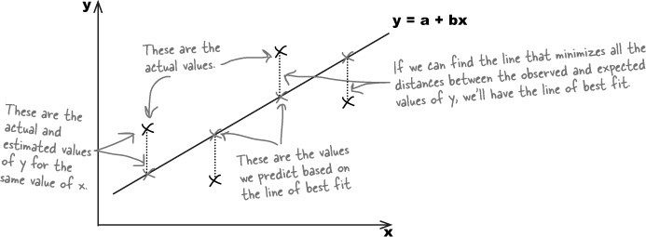
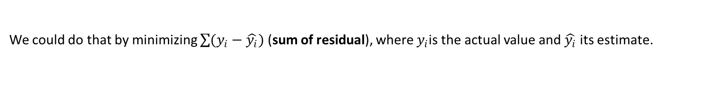
Linear Regression : Process
Line of best fit
We need to minimize errors.
y=a+bx
Actual Values
Line of best fit is the line that minimizes all the distances (residuals) between the Actual and Estimated values
Actual and Estimated values of y for the same x
Predicted values based on line of best fit
We could do that by minimizing $\sum{(y_{i}−\hat{y_{i}})}$ (sum of residual), where $y_{i}$is the actual value and $\hat{y_{i}}$ its estimate.

Slide 12
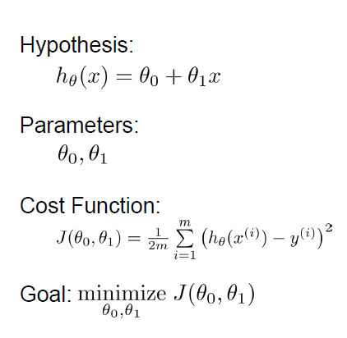
Linear Regression : Process
Cost function Intuition : (OLS or Ordinary Least Square) approach
This method of fitting the line of best fit is called least squares regression.

Slide 13



Linear Regression : Process
Gradient descent is an optimization algorithm that's used when training a machine learning model. It's based on a convex function and tweaks its parameters iteratively to minimize a given function to its local minimum
Have some function
Want
Process Outline:
•Start with some
•Keep changing to reduce until we
hopefully end up at a minimum
After this optimization we achieve best
equation to describe linear relationship
between x and y
Y = mx +c

Slide 14
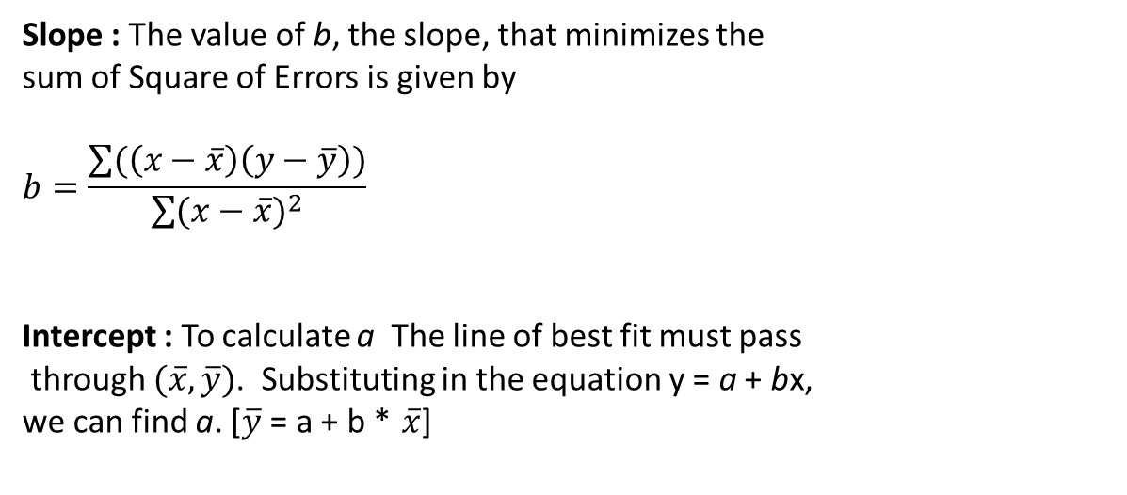
Components
y=a+bx Line of Best Fit
b
Slope : The value of b, the slope, that minimizes the
sum of Square of Errors is given by
$$b=\frac{\sum{(\left(x−\overline{x}\right)\left(y−\overline{y}\right))}}{\sum{{(x−\overline{x})}^{2}}}$$
Intercept : To calculate a The line of best fit must pass
through $(\overline{x},\overline{y})$. Substituting in the equation y = a + bx,
we can find a. [$\overline{y}$ = a + b * $\overline{x}$]
a
X | Y
Sunshine (hours) | Concert attendance
1.9 | 22
2.5 | 33
3.2 | 30
3.8 | 42
4.7 | 38
5.5 | 49
5.9 | 42
7.2 | 55

Slide 15
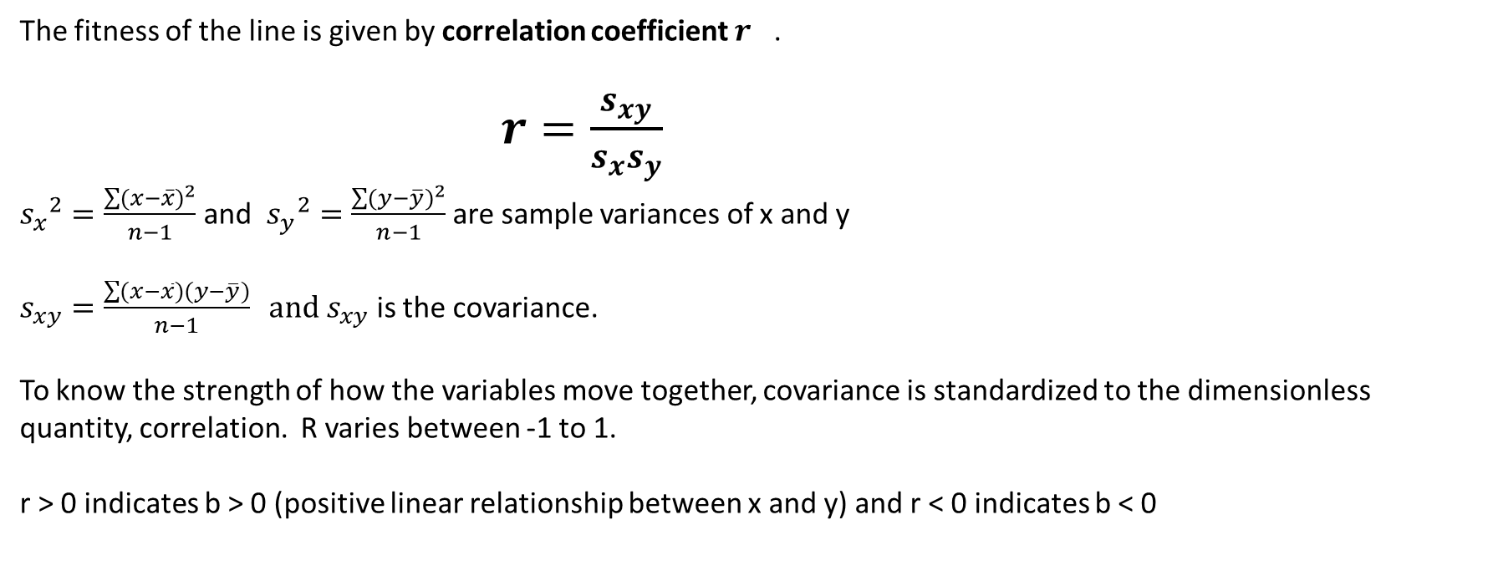
Level of Fitment: Strength of Linear Relationship
X | Y
Sunshine (hours) | Concert attendance
1.9 | 22
2.5 | 33
3.2 | 30
3.8 | 42
4.7 | 38
5.5 | 49
5.9 | 42
7.2 | 55
y=a+bx Line of Best Fit
The fitness of the line is given by correlation coefficient $r^{}$.
$r=\frac{s_{xy}}{s_{x}s_{y}}$
${s_{x}}^{2}=\frac{\sum{{(x−\overline{x})}^{2}}}{n−1}$ and ${s_{y}}^{2}=\frac{\sum{{(y−\overline{y})}^{2}}}{n−1}$ are sample variances of x and y
$s_{xy}=\frac{\sum{(x−\overline{x})(y−\overline{y})}}{n−1} and s_{xy}$ is the covariance.
To know the strength of how the variables move together, covariance is standardized to the dimensionless quantity, correlation. R varies between -1 to 1.
r > 0 indicates b > 0 (positive linear relationship between x and y) and r < 0 indicates b < 0

Slide 16
Level of Fitment : Variance Explained (Other Angle)

Slide 17
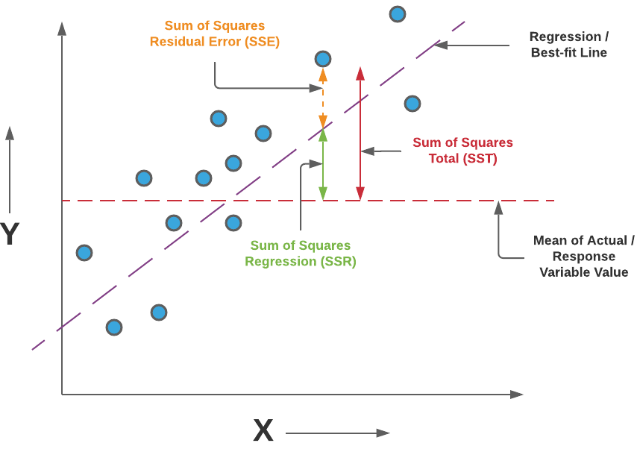

Level of Fitment : Variance Explained (Other Angle)
SSE = Sum of squared errors/residuals
[The value of SSE is a measure of the error in
linear equation (y = mx+c.)
The sum of squares of these residuals or errors is the
quantity that is minimized by the least squares method.]
SST = the difference $y_{i}−$ $\overline{y}$ (mean of y) provides a measure of
the error involved in using$\overline{ y}$to estimate
predictions. The corresponding sum of squares, called the
total sum of squares, is denoted SST.
SSR = how much the $\hat{y_{i}}$values on the y=mx+c deviate from$\overline{y }$, another sum of squares is computed. This sum of squares, called the sum of squares due to regression (SSR).

Slide 18
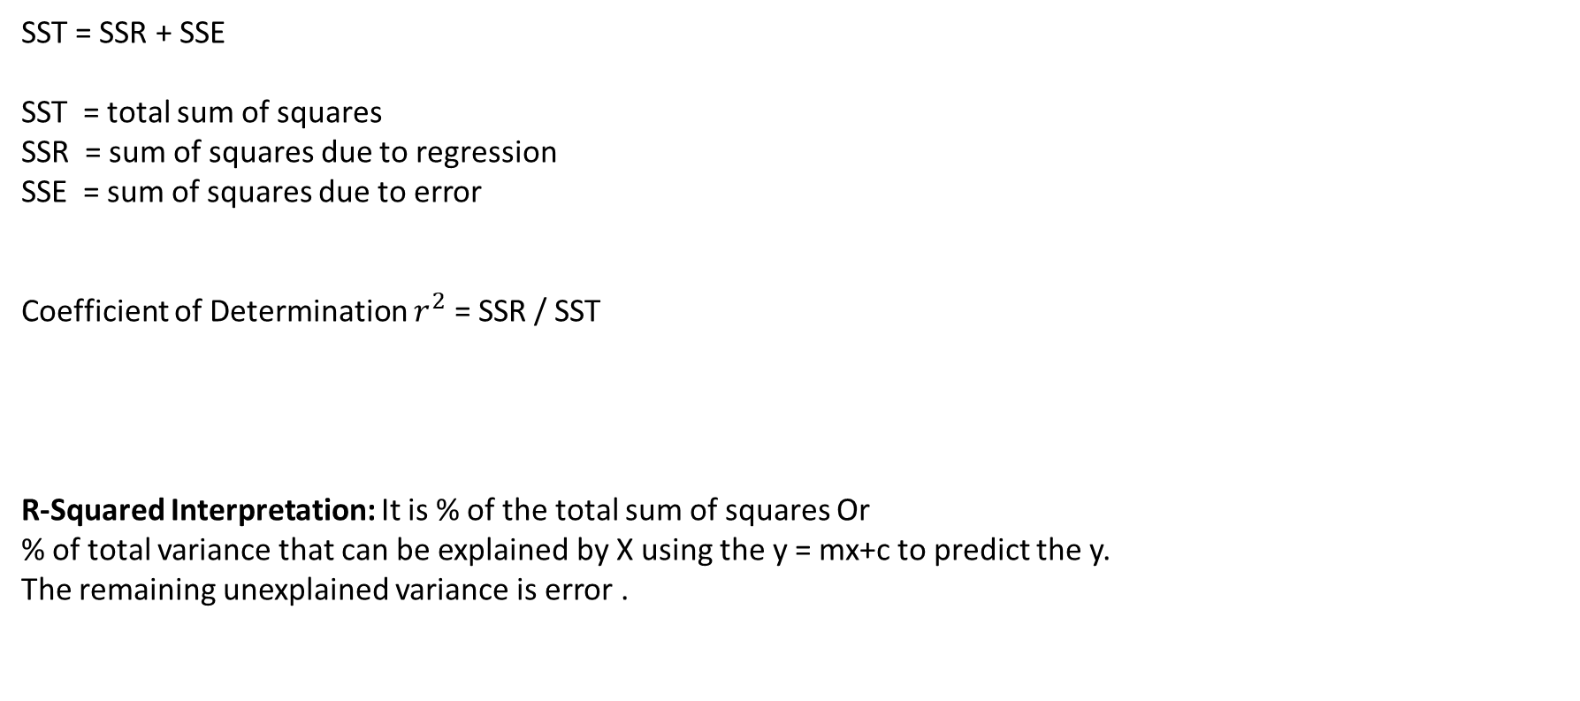
Level of Fitment : Variance Explained (Other Angle)
Coefficient of Determination
SST = SSR + SSE
SST = total sum of squares
SSR = sum of squares due to regression
SSE = sum of squares due to error
Coefficient of Determination $r^{2}$ = SSR / SST
R-Squared Interpretation: It is % of the total sum of squares Or
% of total variance that can be explained by X using the y = mx+c to predict the y.
The remaining unexplained variance is error .

Slide 19
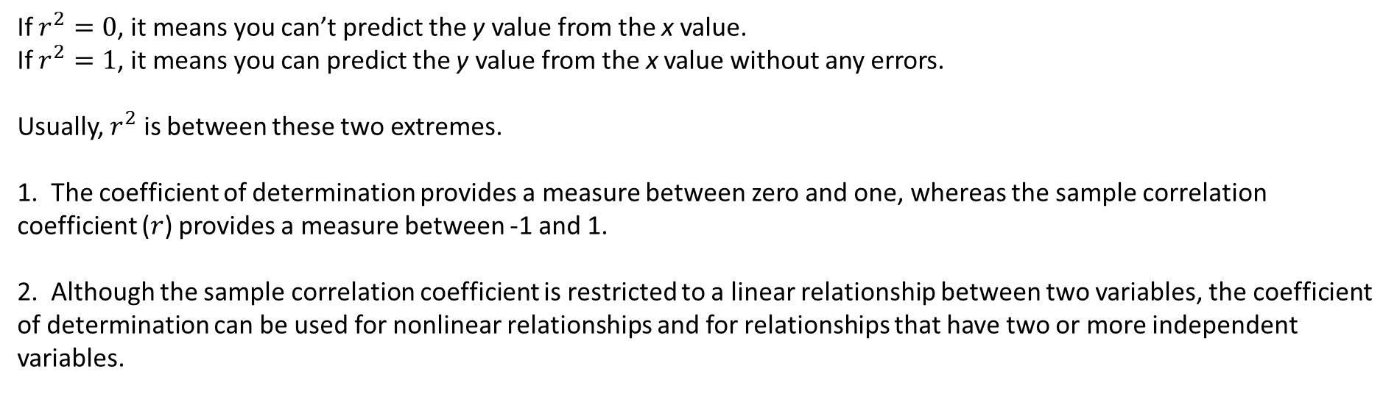
Level of Fitment : Other Angle
Coefficient of Determination
If $r^{2}=0$, it means you can’t predict the y value from the x value.
If $r^{2}=1$, it means you can predict the y value from the x value without any errors.
Usually, $r^{2}$ is between these two extremes.
1. The coefficient of determination provides a measure between zero and one, whereas the sample correlation coefficient ($r$) provides a measure between -1 and 1.
2. Although the sample correlation coefficient is restricted to a linear relationship between two variables, the coefficient of determination can be used for nonlinear relationships and for relationships that have two or more independent variables.

Slide 20
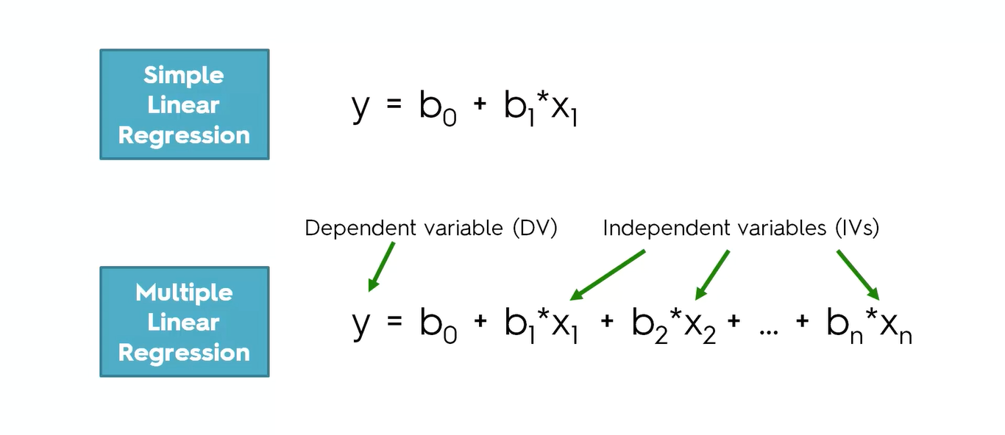
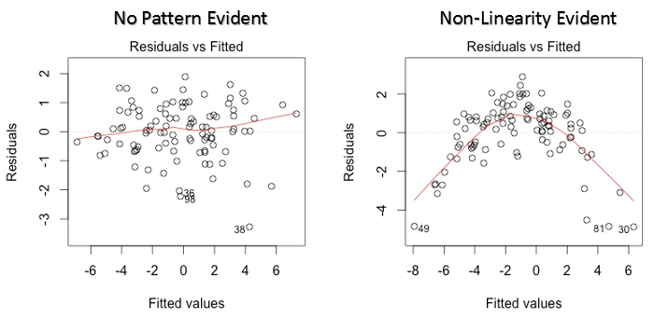
Regression : Assumptions
There should be a linear and additive relationship between dependent variable and independent variable(s).
This means Coefficients of each Ind. variable is not affected by other I.V. and should be linearly related to D.V.
Linearity can be checked using Scatter plot (X and Y) or
residuals Vs Fitted value curve.
A horizontal trend line in the plot indicates absence of
nonlinear patterns between response and predictors
2. This assumes that the errors of the response variables are uncorrelated with each other. Mostly
This phenomena appears in time series data and called autocorrelation. Durbin – Watson (DW) statistic can be used to measure autocorrelation. It must lie between 0 and 4.
Notes:
https://www.analyticsvidhya.com/blog/2016/07/deeper-regression-analysis-assumptions-plots-solutions/

Slide 21
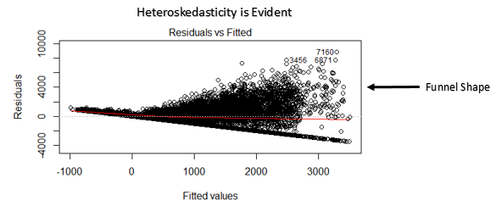
Regression : Assumptions
Independent variables should not be correlated among each other. If they are correlated,
then multicollinearity is said to be present. Check VIF (variance inflation factor) to check multicollinearity.
0< VIF <10 (moderate multicollinearity) ::: VIF > 10 (High multicollinearity)
4. The error terms must have constant variance. This phenomenon is known as homoskedasticity. look at residual vs fitted values plot. If heteroskedasticity exists, the plot would exhibit a funnel shape pattern.

Slide 22
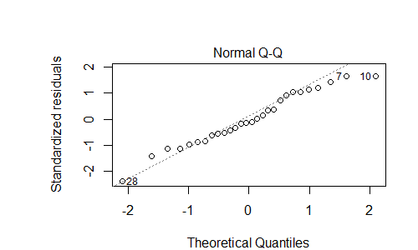
Regression : Assumptions
5. The error terms must be normally distributed. This can be checked using Q-Q Plot.
Absence of normality in the errors can be seen with deviation in the straight line.

Slide 23
Multiple Linear Regression
•Multiple regression is an extension of simple linear regression
•Two or more independent variable are used to explain the variance in the dependent variable.
Sale of Product = 100 + 10*(Distance k.m. of warehouse) – 132.3*(Product Price in Rs)

Slide 24
Multiple Linear Regression
New Considerations : Adding more independent variables doesn’t mean that the regression will be better; in fact it can make things worse.
Overfitting
–Is caused by adding too many independent variables. Built model describes random error or noise instead of the underlying relationship. Model will be too complex that it will fail to generalize well on test data (unseen data)
Multicollinearity
–The addition of more independent variables creates more relationship among them.
–Not only are the independent variables correlated to the dependent variable, they are also potentially correlated to each other.

Slide 25
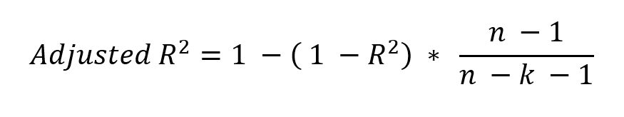
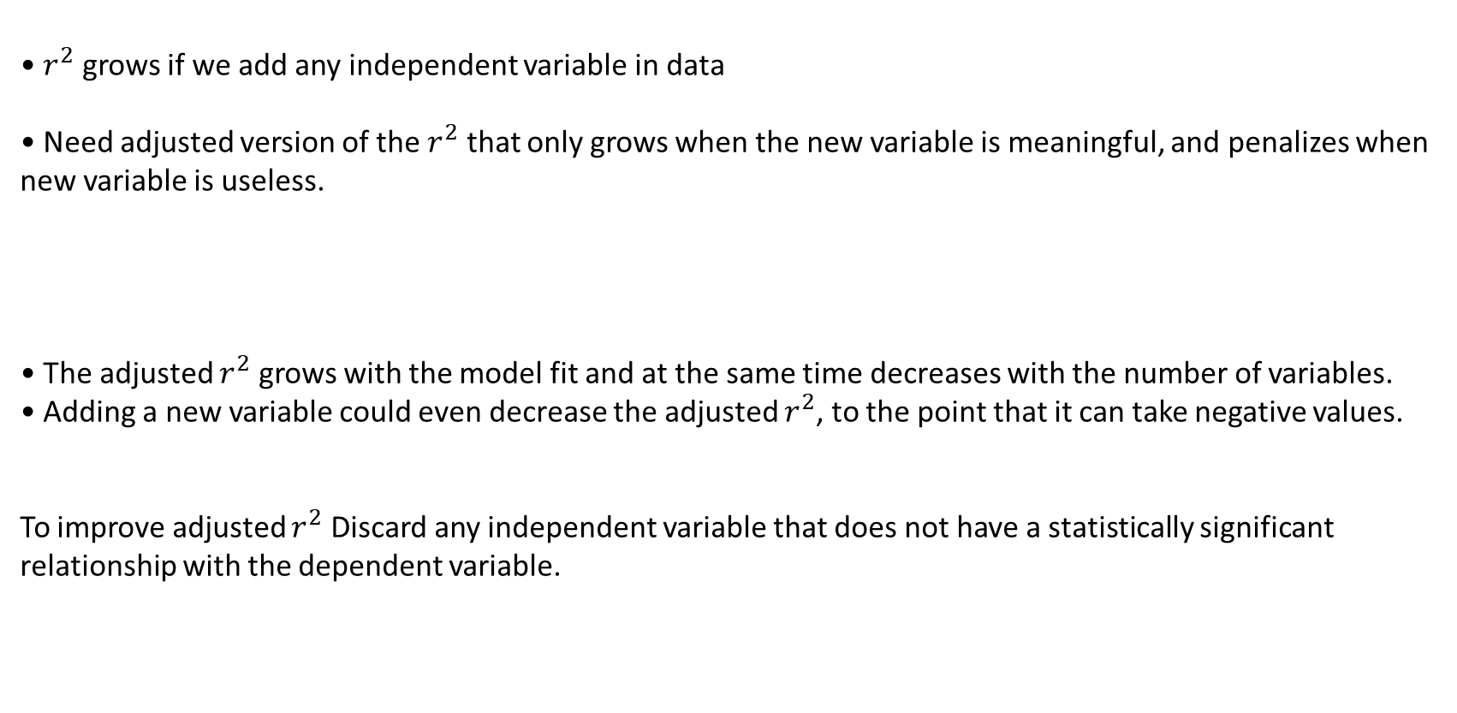
Multiple Linear Regression
• $r^{2}$ grows if we add any independent variable in data
• Need adjusted version of the $r^{2}$ that only grows when the new variable is meaningful, and penalizes when new variable is useless.
• The adjusted $r^{2}$ grows with the model fit and at the same time decreases with the number of variables.
• Adding a new variable could even decrease the adjusted $r^{2}$, to the point that it can take negative values.
To improve adjusted $r^{2}$ Discard any independent variable that does not have a statistically significant relationship with the dependent variable.

Slide 26
Multiple Linear Regression
STEPS in Multiple Linear Regression
Collect data on the variables
Check the relationships between each IV and DV using scatterplots and correlations. (Check normalization requirement)
Check the relationships between IV using VIF. (Check multicollinearity)
4. Reduce dimension or select features based upon conditions.
5. Use the non-redundant independent variable in the analysis to find the best fitting model

Slide 27
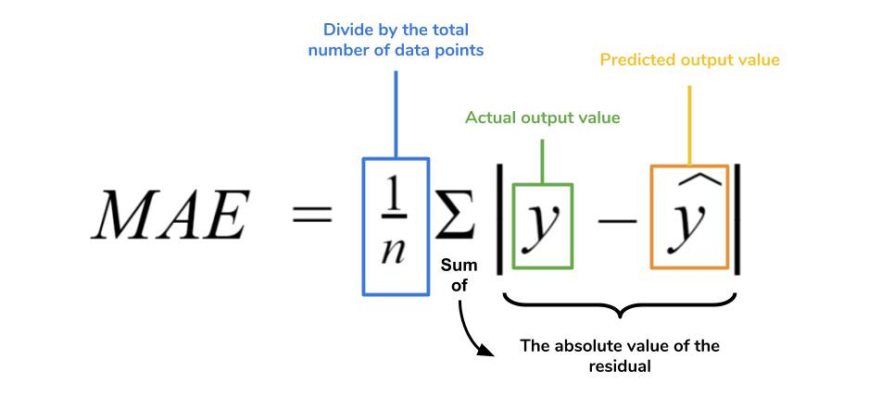
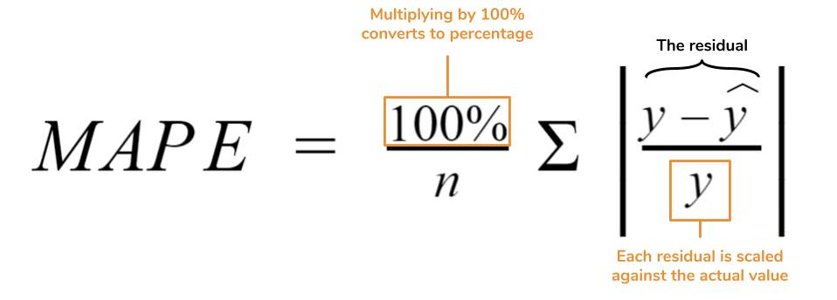
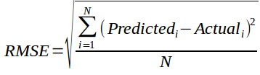
Regression Modelling
Performance validation of Regression Modelling
MAE (Mean Absolute Error): Mean of the absolute value of the
difference between the predicted and actual values.
MAPE (Mean Absolute Percentage Error): Same as above but
converted into percentages to allow for comparison across different scales
RMSE (Root Mean Square Error): Accounts for infrequent large errors,
whose impact may be understated by the mean-based error measures.

Slide 28
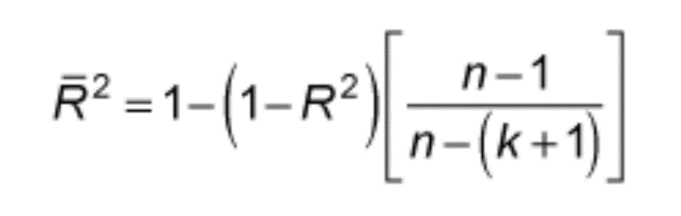
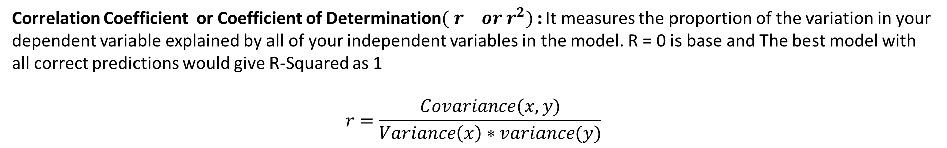
Regression Modelling
Performance validation of Regression Modelling
Correlation Coefficient or Coefficient of Determination${( r^{} or r}^{2})$: It measures the proportion of the variation in your dependent variable explained by all of your independent variables in the model. R = 0 is base and The best model with all correct predictions would give R-Squared as 1
$$r=\frac{Covariance(x,y)}{Variance\left(x\right)∗variance(y)}$$
Adjusted R-Squared : on adding new features to the model, the R-Squared value either increases or remains the same. R-Squared does not penalize for adding features that add no value to the model. So an improved version over the R-Squared is the adjusted R-Squared

Slide 29
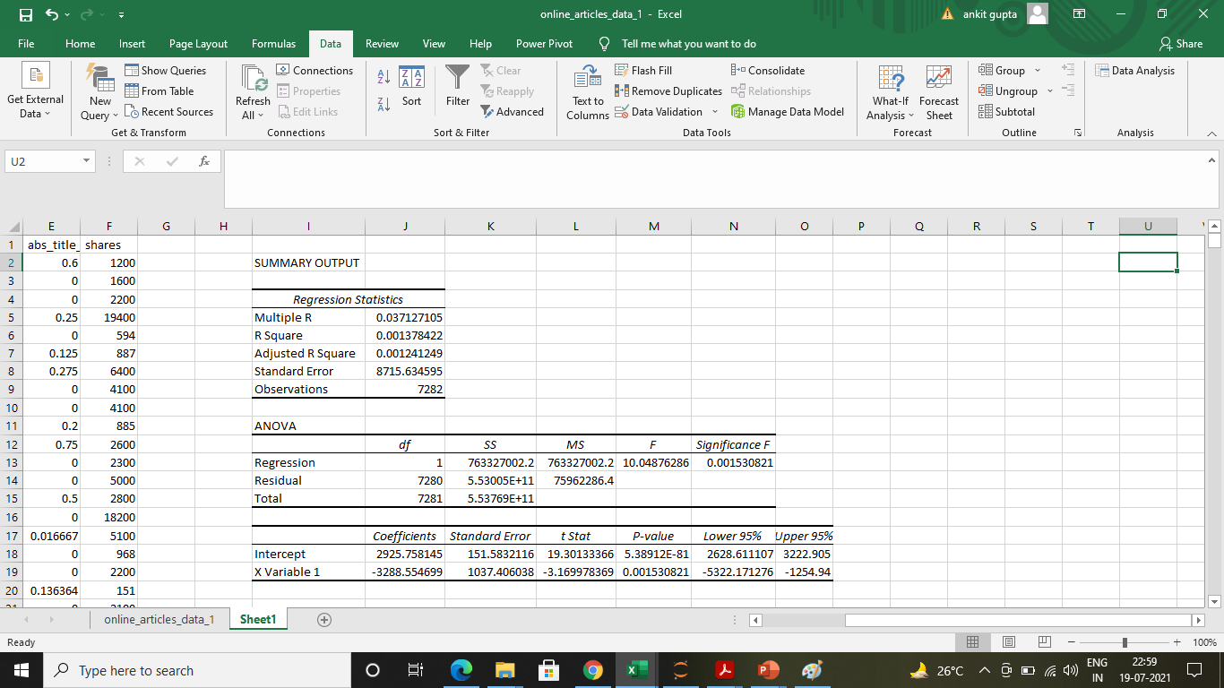
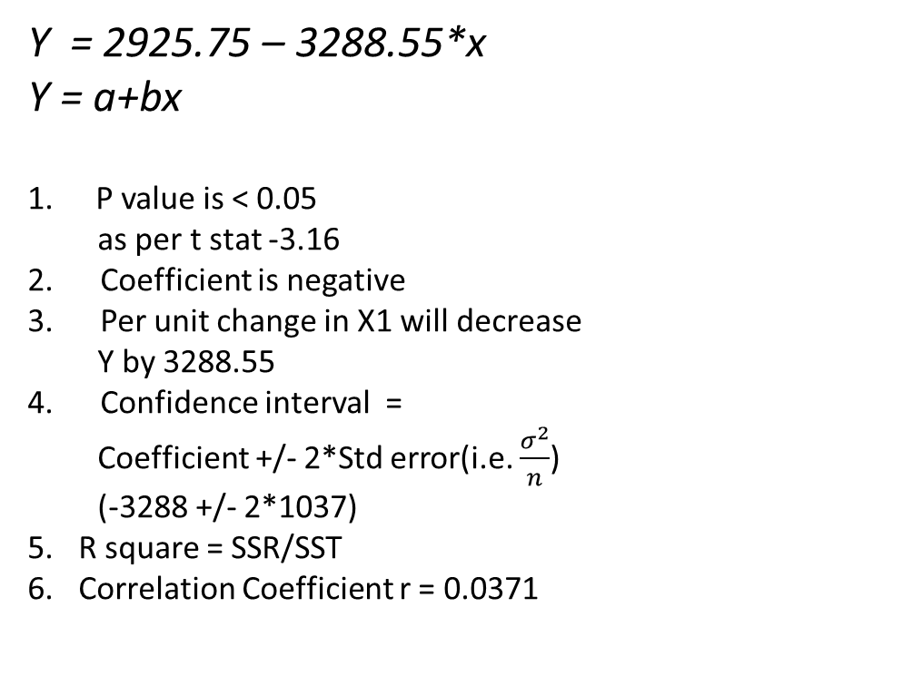
Output Interpretation : Simple Linear Regression
Y = 2925.75 – 3288.55*x
Y = a+bx
P value is < 0.05
as per t stat -3.16
2. Coefficient is negative
3. Per unit change in X1 will decrease
Y by 3288.55
4. Confidence interval =
Coefficient +/- 2*Std error(i.e. $\frac{σ^{2}}{n}$)
(-3288 +/- 2*1037)
R square = SSR/SST
Correlation Coefficient r = 0.0371

Slide 30
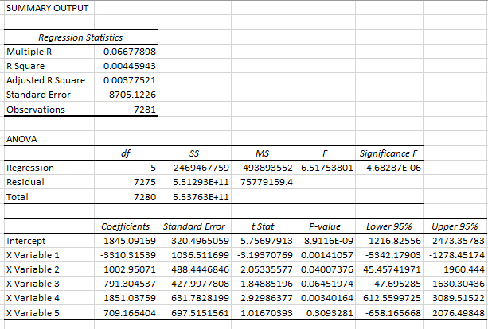
Output Interpretation : Multiple Linear Regression
Y = 1845.09 – 3310.55*x1+
1002.9*x2+ 791.30*x3+
1851*x4+709.166X5
X1 and X4 are having p value <0.05. These are
Statistically significant to predict y value
2. Except X1 all variables have positive relationship with y
3. R square have increased after including more variable

